Slide 1

AI Mental Fitness Tracker

Slide 2
Team Members:
Nishant Naman(2006323)
Sachin Kumar Singh(2006333)
Ankit Prince(2006372)
Mayank Kumar Singh(2006320)

Slide 3
OVERVIEW
In today’s date data analysis is need for every data analytics to examine the sets of data to extract the useful information from it and to draw conclusion according to the information.
Data analytics techniques and algorithms are more used by the commercial in dustries which enables them to take precise business decisions. It is also used by the analysts and the experts to authenticate or negate experimental layouts, assumptions and conclusions. In recent years the analytics is being used in the field of health and fitness to predict and draw various insights.
The Mental Health Fitness Tracker Project aims to develop an AI-Driven solution for analyzing and predicting mental fitness levels of individuals with various mental disorder.
Keywords: Regression Algorithms, Numpy, Pandas, Seaborn, Matplotlib

Slide 4
INTRODUCTION
Machine Learning is a branch of Artificial Intelligence that aims at solving real-life engineering problems. This technique requires no programming, whereas it depends on only data learning where the machine learns from pre-existing data and predicts the result accordingly. Machine Learning methods have benefit of using decision trees, heuristic learning, knowledge acquisition, and mathematical models. It thus provides controllability, observability, stability and effectiveness.
In an era characterized by the increasing intersection of technology and well- being, the development of innovative solutions to support mental health has become a paramount endeavor. Recognizing the significance of mental well- being in our daily lives, the Mental Health Fitness Tracker, powered by machine learning, emerges as a pioneering project aimed at empowering individuals to proactively manage and understand their mental health.

Slide 5
PROBLEM STATEMENT
The project aims to develop an Al Mental Fitness Tracker using different machine learning algorithms.
By doing so, the Al Mental Fitness Tracker will predict an individual's mental well-being, providing personalized insights and recommendations to help users monitor and improve their mental fitness over time.

Slide 6
Agenda:
Data Collection
Exploratory Data Analysis
Model Selection
Feature Engineering
Testing & Deployment

Slide 7
End Users of this Project
Mental Health Seeking Individuals
Mental Health Professionals
Researchers/Academics
Healthcare Organizations

Slide 8
BACKGROUND CONCEPT
MACHINE LEARNING:
Machine learning (ML) is a field devoted to understanding and building methods that let machines "learn" – that is, methods that leverage data to improve computer performance on some set of tasks.
Machine learning algorithms build a model based on sample data, known as training data, in order to make predictions or decisions without being explicitly programmed to do so.
Machine learning algorithms are used in a wide variety of applications, such as in medicine, email filtering, speech recognition, agriculture, and computer vision, where it is difficult or unfeasible to develop conventional algorithms to perform the needed tasks.
PYTHON:
Python is a high-level, general-purpose programming language. Its design philosophy emphasizes code readability with the use of significant indentation via the off-side rule.

Slide 9
PANDAS:
Pandas is a Python package that provides fast, flexible, and expressive data structures designed to make working with "relational" or "labeled" data both easy and intuitive. It aims to be the fundamental high-level building block for doing practical, real world data analysis in Python.
NUMPY:
NumPy is a library for the Python programming language, adding support for large, multi-dimensional arrays and matrices, along with a large collection of high-level mathematical functions to operate on these arrays.

Slide 10
SYSTEM CONFIGURATION
Harware -
10th gen Intel i7-1065G7
16GB DDR4 Memory
512GB PCIe NVMe SSD
Windows 10 (81X1002SUS)
Software -
PYTHON
MACHINE LEARNING
AI

Slide 11
PROPOSED MODEL
Data Collection
Data Preprocessing
Feature Engineering
Model Selection
Model Training/Testing
Deployment

Slide 12
Model development and Evaluation
Here, we have developed a generic model and applied all classification methods. The data is split into training data and test data, we train the model using certain features and use it to predict the testing data, then we calculate the performance of the system.
Process adopted for Prediction of Mental Health Fitness.

Slide 13
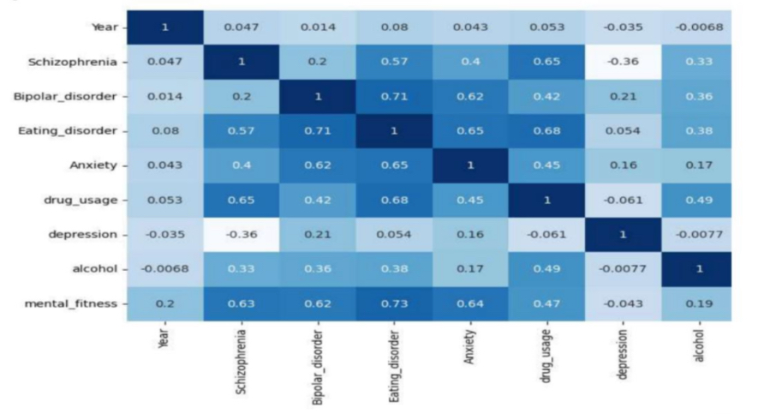
Result:

Slide 14
Conclusion
The Mental Health Fitness Tracker using machine learning presents a promising and innovative approach to supporting individuals in their mental well-being journey.
The Mental Health Fitness Tracker can evolve through user feedback, continuous improvement of machine learning models, and integration with emerging technologies. Collaboration with mental health professionals and researchers can further enhance the project's efficacy and contribute valuable insights to the broader mental health community.

Slide 15
FUTURE SCOPE
The Mental Health Fitness Tracker can evolve through user feedback, continuous improvement of machine learning models, and integration with emerging technologies. Collaboration with mental health professionals and researchers can further enhance the project's efficacy and contribute valuable insights to the broader mental health community.
Ultimately, this project represents a step towards a holistic and technology- driven approach to mental well-being, emphasizing the importance of proactive self-care and destigmatizing conversations around mental health. As the field of mental health technology continues to advance, projects like the Mental Health Fitness Tracker hold the potential to make a meaningful impact on individuals' lives and contribute to a more comprehensive understanding of mental health.

Slide 16
References:
[1 ]S. M. Metev and V. P. Veiko, Laser Assisted Microtechnology, 2nd ed., R. M. Osgood, Jr., Ed. Berlin, "AGeIrmManye: Snptrianglerh-Vearlalgt,h199f8i.tness tracker using Machine Learning
Te[2c] Bhrnecikqlinug,eEsd"., The Analysis of Directional Time Series: Applications to Wind Speed and Direction, ser. Lecture Notes in Statistics. Berlin, Germany: Springer, 1989, vol. 61.
by Rahul Nairon Medium:
https://towardsdatascience.com/mental-health-fitness-using-machine
[3] S. Zhang, C. Zhu, J. K. O. Sin, and P. K. T. Mok, “A novel ultrathin elevated channel low-temperature poly-
Si TFT,” IEEE Electron Device Lett., vol. 20, pp. 569–571, Nov. 1999.
-learning-fc62e1d99da0

Slide 17
[4] M. Wegmuller, J. P. von der Weid, P. Oberson, and N. Gisin, “High resolution fiber distributed measurements with coherent OFDR,” in Proc. ECOC’00, 2000, paper 11.3.4, p. 109.
[5] R. E. Sorace, V. S. Reinhardt, and S. A. Vaughn, “High-speed digital-to-RF converter,” U.S. Patent 5 668 842, Sept. 16, 1997.
"AI Mental health fitness tracker using Machine Learning

Slide 18
Thank you

